Slide 1


Western Power Hack-a-Gig
Team UnicorNN

Slide 2
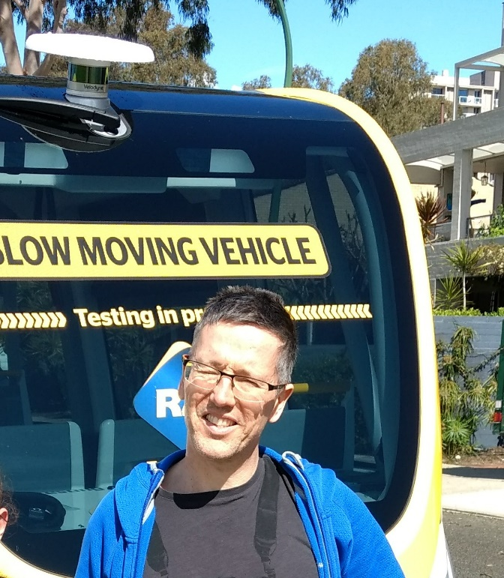

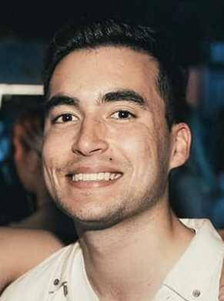
Team UnicorNN
Sofia Sibanic
Electrical Engineer (Western Power) looking to broaden her skillset and apply learnings from fast.ai.
Adrian Goldberg
Geophysicist (Santos) with >10 years programming and ~2 years deep learning experience.
Jordan Pratt
Data Strategy Analyst (Western Power) looking to expand personal skills.

Slide 3
Our Overall Approach
Initial idea was to split the team in half and share learnings
Team members choose what they are interested in
We undertook both challenges, but only Part A of Challenge 2
Learnings captured on GitHub repository wiki
Queries and tasks managed via team Slack channel

Slide 4
Challenge 1
Smart Meter Data

Slide 5
Challenge 1 – Smart Meter Data
The Challenge
Approach
Findings
Key Learnings

Slide 6
The Challenge
<Challenge Summary>
Notes:
Initially started on own but requested to join team UnicorNN
Createing a clean dataset took 80% of time for this project

Slide 7
Our approach
Adrian interested in time series problems.
Understanding – explored problem, objectives and recommendations.
Research – literature and open source code for similar datasets
Data – created clean test, and train datasets
Selected RMSE metric as metric for all forecasts
Forecasting – tried 9 model types, simple through complex
Clustering – explored several methods – chose a novel approach.
Notes:
Initially started on own but requested to join team UnicorNN
Createing a clean dataset took 80% of time for this project

Slide 8
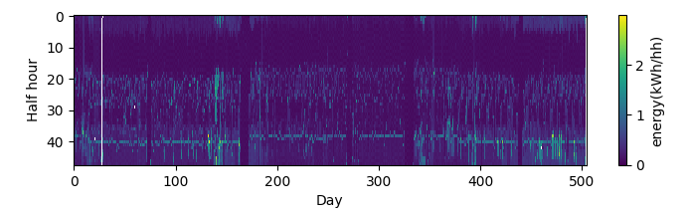
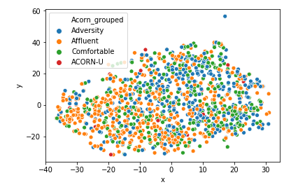
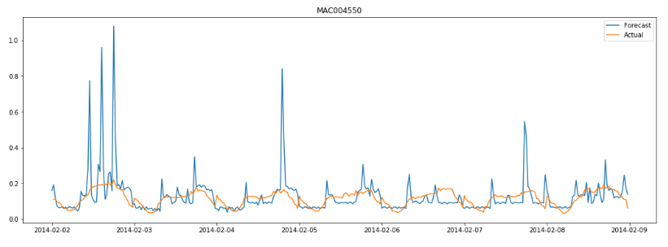
We found…
Inconsistencies in the acquisition data
A relationship between Customer groups and
consumption patterns
Several methods to reasonably
accurately forecast 7 days ahead
Notes:
Data inconsistencies: gaps, varying start/stop dates for smart-meter acquisition.

Slide 9
We learnt…
Use a sample dataset first – then run on full dataset
LightGBM is robust, quick to run - good forecasting performance.
LSTM for forecasting half hourly data gives good results but is really slow.
Converting the energy consumption curves to images and using a Neural Network to cluster is relatively fast and is worth further exploration
Notes:
- break the data down into a manageable size as quickly as possible -
– build models on this, then run the workflows on the larger dataset.
Clustering large time series datasets using kNN and dynamic time warping
is very compute intensive

Slide 10
Challenge 2
Photovoltaic generation
PART A - Detection

Slide 11
Challenge 2 – Photovoltaic Generation
The Challenge
Approach
Findings
Key Learnings

Slide 12
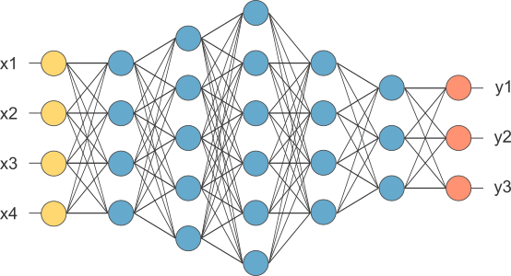
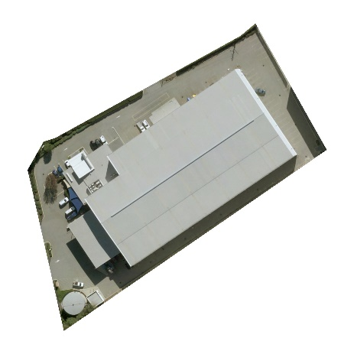
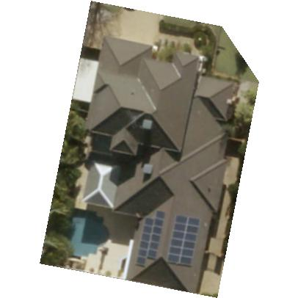
The Challenge (Part A)
Input
Model
Output
Aerial imagery
Metadata
Image recognition

Slide 13
Overview
1
Retrieve Data
2
3
Explore Data
Prepare Data
4
Develop model
5
Assess performance
6
Submit Model
Define requirements
Understand task
Analyse data
Form an approach
Consider limitations
Determine deliverables
Follow to-do list (right)
Document learnings
Share insights

Slide 14
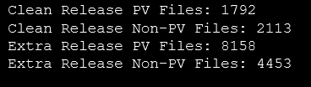
Approach
Understand Data
What is provided?
~16,500 total images
Clean Release
High degree of assumed PV and Non-PV image labelling accuracy
Smaller set
Extra Release
Lower degree of confidence in labelling accuracy
Larger set (2-4x)

Slide 15
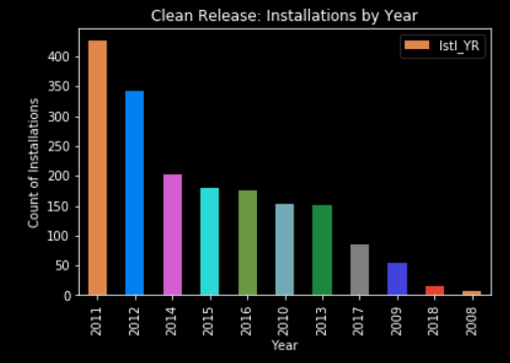
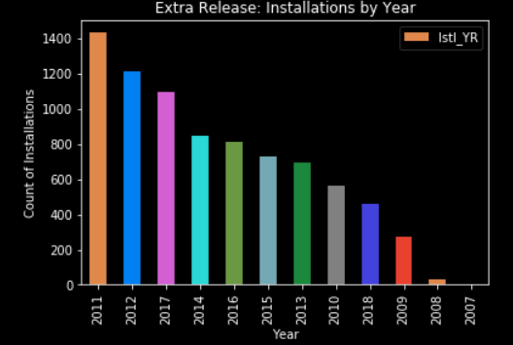
Approach
Majority of installation images from 2011/2012
Range of installation years begins in 2007
Installation data prior to 2007 may be missing or limited in WP databases
Understand Data
What does it tell us?

Slide 16
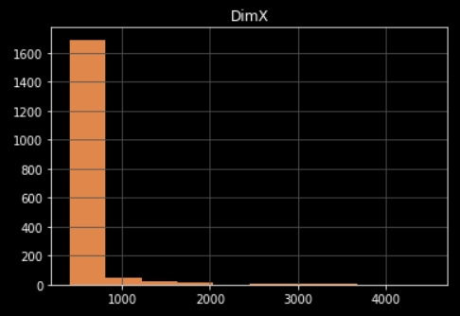
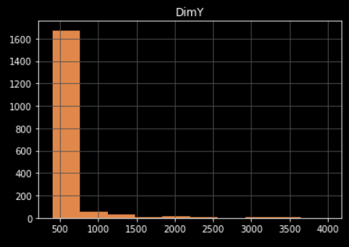
Approach
< Replace all images here with actuals, show variation>
Understand Data
How does it look?

Slide 17
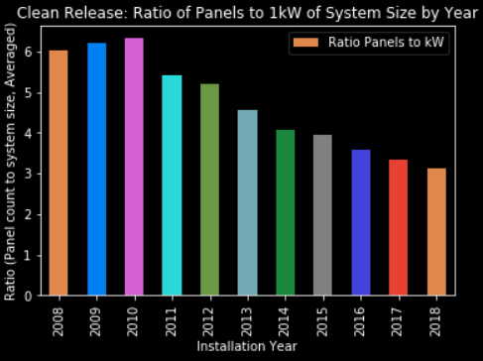
Approach
Exponential system size increase based on annualised data
Increased system sizes partly attributable to panel efficiency gains (W/m²)
Understand Data

Slide 18
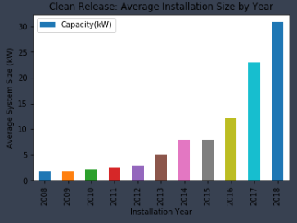
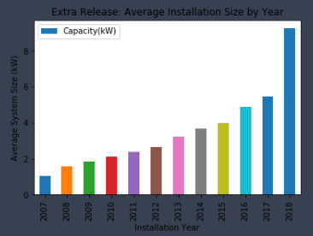
Approach
Understand Data
Unusual for
residential!

Slide 19
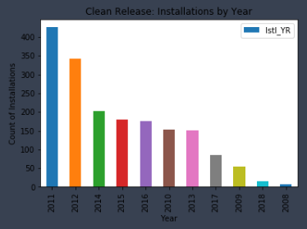
Approach
sample size in these years (<100) skews the mean installation size

Slide 20
Approach
What may create false positives?
Air-conditioning units | Vehicles | Drawn-out shadows
Pools | Pergolas | Roof-tie structures
Elevated roof sections | Solahart water-heating units | Commercial ducting
Commercial walkways | Parking spaces and driveways | Water tanks
Tarps | Trampolines
What may create false negatives?
Rectangular images | Objects covering panels | Poorly angled panels
Lack of visible panel edges | Shade (unlikely)

Slide 21
Approach
What may create false negatives?
Rectangular images | Objects covering panels | Poorly angled panels
Lack of visible panel edges | Shade (unlikely)

Slide 22
The Model
Convolutional Neural Net (CNN) model
Leverages the Fast.AI wrapper on top of PyTorch
Specifies:
Data set to utilise
Functions to split source data into a training & validation set
Functions to import image meta-data
Learning rate specification and annealing
Data augmentation
Result accuracy based on confusion matrix output

Slide 23
We found…
First training epoch (last layer only): 86.4% accuracy
False negatives generally occurred where panel edges were not visible
False positives generally occured on grid-like structures (tiles, pergolas etc)
Accuracy with different approaches ranged from 86.4% to 97.9%

Slide 24
What didn’t work...
Tweaking the model by increasing dropout
Dropout tends to improve model generalisation
Significant data augmentation:
With blur – similar principle to the above – seemed to be counterproductive by reducing accuracy
30 degree image tilt – To better generalise house (and by proxy panel) positioning – reduced the validation set accuracy
Perhaps we were using the wrong type of augmentation?
Moving up to a more complex model took far longer to train and did not yield a performance increase.

Slide 25
We learned…
Following the basic fast.ai principles yields generally accurate CV results
Minimising data augmentation helped
Randomising the test set and validation set to check yielded model results are not a fluke
How team tasks can be segmented better in the future to accelerate works

Slide 26
What worked?
Dropout
No dropout results in rapid overfitting – not recommended
Default dropout of 25% (first dropout layer) and 50% (second dropout layer) in the resnet34 model worked well

Slide 27
Challenge 2
Photovoltaic generation
PART B - SIZING

Slide 28
Overview
Part B continues from Part A code
PV image Metadata is accessible in the Jupyter Notebook

Slide 29
Thank you for your attention.
Team UnicorNN

